Slide 1
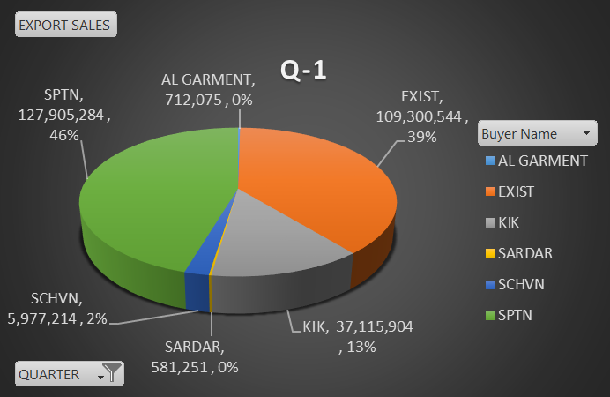
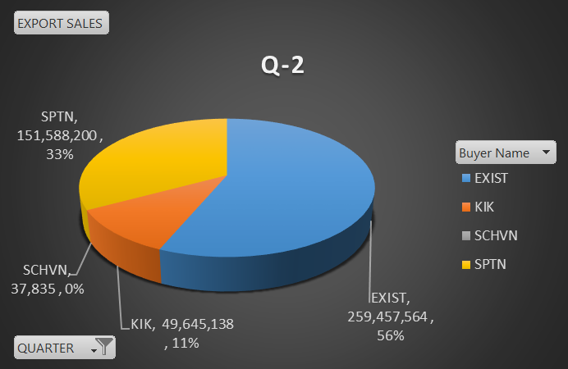
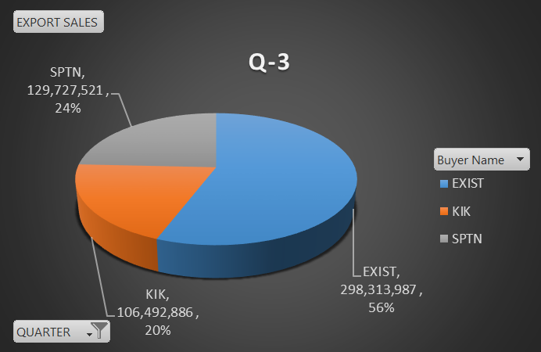
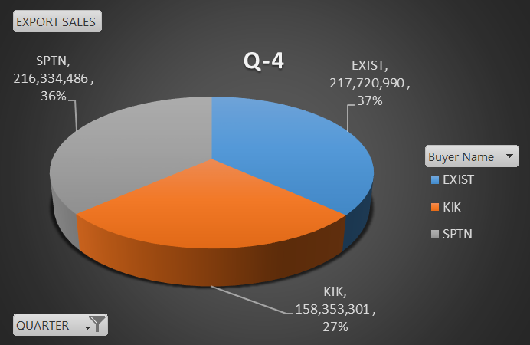
MANUFACURER AND EXPORTER OF KNITTED GARMENTS
Export Sales From Jul-2021 To June-2022
 |  |  |  |  | PKR
BUYER NAME | Q-1 | Q-2 | Q-3 | Q-4 | Grand Total
AL GARMENT | 712,075 | - | - | - | 712,075
EXIST | 109,300,544 | 259,457,564 | 298,313,987 | 217,720,990 | 884,793,085
KIK | 37,115,904 | 49,645,138 | 106,492,886 | 158,353,301 | 351,607,229
SARDAR | 581,251 | - | - | - | 581,251
SCHVN | 5,977,214 | 37,835 | - | - | 6,015,049
SPTN | 127,905,284 | 151,588,200 | 129,727,521 | 216,334,486 | 625,555,491
Grand Total | 281,592,272 | 460,728,738 | 534,534,394 | 592,408,776 | 1,869,264,180

